Slide 1
1 Seasonal adjustment
ESTP Training
05-07 October 2026

Slide 2
0. Outline
ESS guidelines
  Objectives
  Methods
Series decomposition
Overview of seasonal adjustment methods
Outline of the training
Final remarks

Slide 3
1. ESS Guidelines (2024)
Background and basic definitions
Seasonal adjustment is a fundamental process in the correct interpretation of short-term time series movement to inform policy makers.
Seasonal fluctuations and calendar effects can mask short and long-term movements in a time series and impede a clear understanding of underlying phenomena. Seasonal adjustment filters out usual seasonal fluctuations and typical calendar effects from a time series.
Usual seasonal fluctuations mean those movements which recur with similar intensity in the same season each year and which, based on the past movements of the time series in question and under normal circumstances, can be expected to recur. Calendar effects arise from annual differences in the number of working or trading days in a month or a quarter, or the dates or days of public holidays.

Slide 4
Movements due to exceptionally strong or weak seasonal influences, for example extreme weather conditions or atypical holiday patterns, will continue to be visible in the seasonally adjusted series. Other random disruptions and unusual movements with real-world interpretations, for example strikes or large orders, will also continue to be visible.
Hence, the seasonally adjusted results do not show “normal” and repeating events but do show the “news” in the time series, for example latest movements of the trend, the business cycle or the irregular components as well as the occurrence of turning points.
The downside of seasonal adjustment is that seasonality cannot be precisely defined and different approaches – such as the signal extraction approach (Burman, 1980; Gomez and Maravall, 1996) and the semi-parametric approach based on a set of predefined moving (Shiskin et al., 1967; Findley et al., 1998) – may result in different outcomes.
The expertise of an analyst will also impact on the quality of seasonal adjustment, although the primary drivers are the quality of the unadjusted time series and the production timetable.

Slide 5
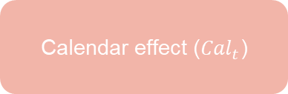
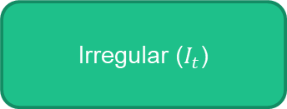

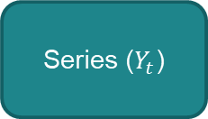

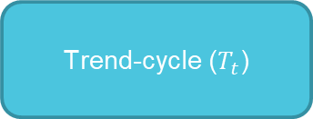
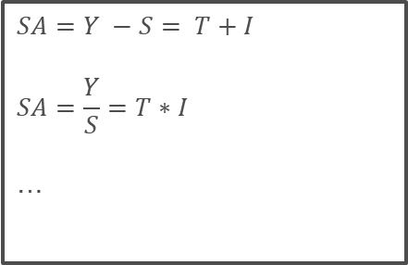
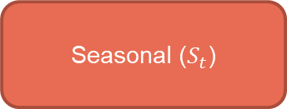
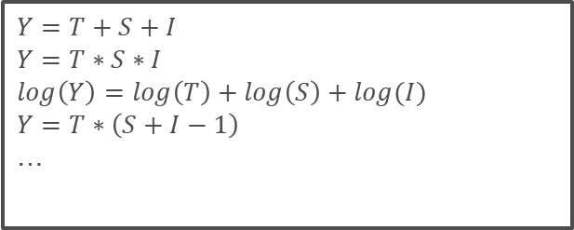
2.1 Series decomposition
Calendar effect (${Cal}_{t}$)
Seasonal ($S_{t}$)
Seasonally adj (${SA}_{t}$)
Series ($Y_{t}$)
$$Y=f(T, S,I)$$
Trend-cycle ($T_{t}$)
$$SA=Y −S= T+I$$
$$SA=\frac{Y}{S}=T∗I$$
…
$$Y=T+S+I$$
$$Y=T∗S∗I$$
$$\log\left(Y\right)=\log\left(T\right)+\log\left(S\right)+log(I)$$
$$Y=T∗\left(S+I−1\right)$$
…
Irregular ($I_{t}$)

Slide 6
2.2 Expected properties of the components
Trend-cycle
  Smooth (?), around the series
Seasonal
  Periodic, with slow changes (?), nearly 0 or 1 in average during 1 cycle (year)
  Calendar effects (predictable)
Irregular
  Residual , around 0 or 1
No actual definition of the components / decomposition
⇒ methods/software give different results

Slide 7

2.3 Non unicity of the series decomposition
$Y=T+ S+I$
$Y=(T+I_{1})+ S+I_{2}$⇒ noisy T, no impact on SA
$Y=T+(S+I_{1})+I_{2}$⇒ noisy S, smoother SA
…
Remark : all those decompositions should pass most of the diagnostics successfully

Slide 8
2.4 Other expected properties of the decomposition
Limited revisions
Robust estimation
Explainable results
Efficient algorithms
…

Slide 9
3. Rapid overview of common SA methods
Non parametric
Parametric
Machine learning
Others
Lo(w)ess
Moving averages
Stochastic
Deterministic
RegArima
models
Structural models
BV4
…
Camplet
STL
X11
Prophet
Canonical decomposition
X12-ARIMA
Stamp,
RegCmp,
(T)Bats,
…
Kalman filter
WK filter
Tramo-Seats

Slide 10
3. Rapid overview of common SA methods
Non parametric
Parametric
Machine learning
Others
Lo(w)ess
Moving averages
Stochastic
Deterministic
JD+ 3.x
RegArima
models
Structural models
BV4
…
Camplet
STL
X11
Prophet
Canonical decomposition
X12-ARIMA
Stamp,
RegCmp,
(T)Bats,
…
Kalman filter
WK filter
Tramo-Seats

Slide 11
4.1.1 Some examples

Slide 12
4.1.2 Some examples

Slide 13
4.2.1 Some examples. Diagnostics
US Retail: Automobile dealers (monthly)
 | Seasonality tests |  |  |  | Trading days tests
 | F | F(last) | QS | Kruskal-Wallis
Camplet | 0.89 | 0.89 | 1.00 | 1.00 | 0.00
Prophet | 1.00 | 0.91 | 0.00 | 1.00 | 0.00
STL | 1.00 | 0.95 | 1.00 | 1.00 | 0.00
STS (td-varying) | 1.00 | 0.89 | 1.00 | 1.00 | 1.00
Tramo-Seats (RSA0) | 1.00 | 0.98 | 0.69 | 1.00 | 0.00
Tramo-Seats (RSAfull) | 1.00 | 0.82 | 1.00 | 0.99 | 0.81
X11 | 0.97 | 0.77 | 0.56 | 1.00 | 0.00
X13 (RSA5c) | 0.97 | 0.92 | 0.99 | 0.75 | 0.83

Slide 14
4.2.2 Some examples. Diagnostics
ABS Retail: X0.2.09.10.M
 | Seasonality tests |  |  |  | Trading days tests
 | F | F(last) | QS | Kruskal-Wallis
Camplet | 0.00 | 0.14 | 0.01 | 0.00 | 0.00
Prophet | 0.00 | 0.27 | 0.00 | 0.12 | 0.00
STL | 1.00 | 0.91 | 1.00 | 1.00 | 0.00
STS (td-varying) | 1.00 | 0.51 | 1.00 | 0.97 | 1.00
Tramo-Seats (RSA0) | 1.00 | 0.85 | 1.00 | 1.00 | 0.00
Tramo-Seats (RSAfull) | 0.98 | 0.84 | 1.00 | 1.00 | 0.01
X11 | 0.98 | 0.94 | 0.01 | 1.00 | 0.00
X13 (RSA5c) | 0.95 | 0.80 | 0.23 | 1.00 | 0.00

Slide 15
4.2.3 Some examples. Diagnostics
US Retail: Total (quarterly)
 | Seasonality tests |  |  |  | Trading days tests
 | F | F(last) | QS | Kruskal-Wallis
Camplet | 0.93 | 0.68 | 1.00 | 0.83 | 0.25
Prophet | 0.86 | 0.70 | 0.44 | 0.66 | 0.12
STL | 0.99 | 0.79 | 1.00 | 0.85 | 0.12
STS (td-varying) | 1.00 | 0.45 | 1.00 | 0.99 | 1.00
Tramo-Seats (RSA0) | 1.00 | 0.83 | 1.00 | 0.91 | 0.20
Tramo-Seats (RSAfull) | 0.44 | 0.44 | 1.00 | 0.73 | 0.33
X11 | 0.95 | 0.76 | 1.00 | 0.45 | 0.14
X13 (RSA5c) | 0.90 | 0.71 | 1.00 | 0.91 | 0.70

Slide 16
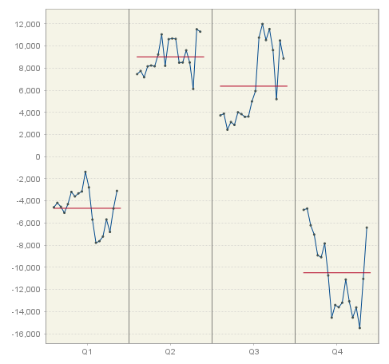
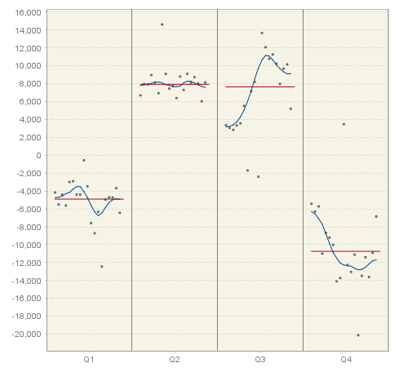
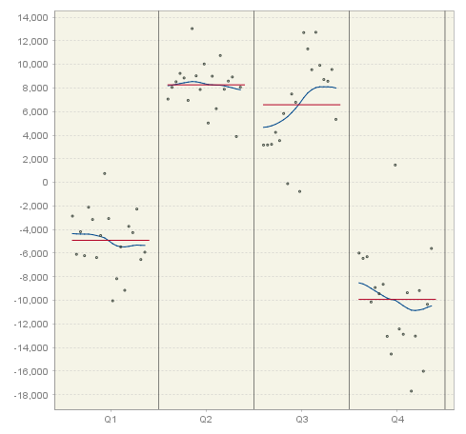
4.3 Some examples. Seasonal pattern
US Retail: Automobile dealers (quarterly)
CAMPLET | X11 | TRAMO-SEATS

Slide 17
5. Final remarks
Need to understand the principles of the main algorithms (not all the technical details)
  Software automates many details
Need for good quality reports
  Recall: “seasonally adjusted series should have neither residual seasonality nor residual calendar effects” + should respect the hypotheses on the components
Need to “industrialize” the seasonal adjustment processing
  Additional request: “Seasonal adjustment procedures should generate consistent and robust results”

